Slide 1
Intelligent Systems Design through Deep Learning
Shaik Nagur Shareef
Software Engineer

Slide 2
Outline
Introduction to Artificial Intelligence
Approaches to achieve AI
Intuition to Machine Learning
Introduction to Deep Learning
Deep Learning Tools & Applications
Feed Forward Neural Networks
Multi Layered Perceptron
Convolutional Neural Network
Feedback Neural Networks
Recurrent Neural Networks (LSTM & GRU)
Transfer Learning
Transformers for Vision & Sequence Modeling

Slide 3

What is Intelligence..???

Slide 4
Intelligence…
Intelligence has been defined in many ways:
The capacity for logic, understanding, self-awareness, learning, emotional knowledge, reasoning, planning, creativity, critical thinking, and problem-solving.
More generally, it can be described as the ability to perceive or infer information, and to retain it as knowledge to be applied towards adaptive behaviours within an environment or context.

Slide 5
What is Artificial Intelligence.?

Slide 6
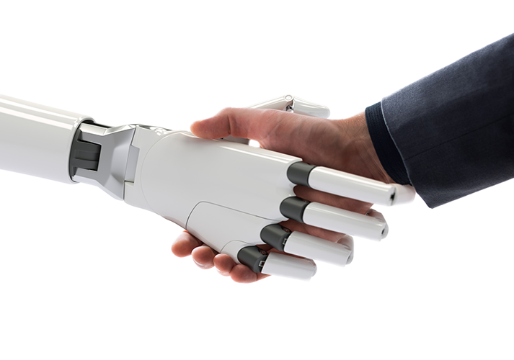
Artificial Intelligence…
Artificial intelligence is the science and engineering of making Intelligent Systems
Artificial: Non Natural
Intelligence: Ability to learn, understand and think
AI can be defined as Making the:
Systems that act & think like Humans
Systems that act & think Rationally
Note: Rationally means doing right thing at right time

Slide 7
Fields of AI
AI is broad branch of computer science.
The goal of AI is to create systems, that can function intelligently and independently.
Humans can speak and listen to communicate through language, in AI is a field of speech recognition.
Humans can read and write a text in a language, in AI is a field of NLP or Natural Language Process.
Humans can see with their eyes and process what they see, in AI is a Computer Vision. This falls under Symbolic Learning.

Slide 8
Fields of AI
Human brain is Network of Neurons and we use this to learn things.
If we replicate the structure and function of human brain, we might be able to get cognitive capabilities of machines. This is a field of Neural Networks.
These networks are more complex and deeper and will use to learn complex things, that is a field of Deep Learning.
There are different types of machine learnings, which are essentially use different techniques to replicate what human brain does.
If a get a network to scan images from left to right and top to bottom it’s a Convolution Neuronal Network.
This CNN is used to recognize objects to seen, this is how Computer Vision fits in an Object Recognition is accomplished through AI.

Slide 9
Fields of AI
Humans recognizes see around them, through eyes which creates images that world, in AI, Image Processing which is not directly not related to AI but required for field of Computer Vision.
Humans can understand their environment and move around fluently, this is a field of Robotics.
Humans has ability to see patterns such as grouping like objects, this is a field of Patterns Recognition.

Slide 10
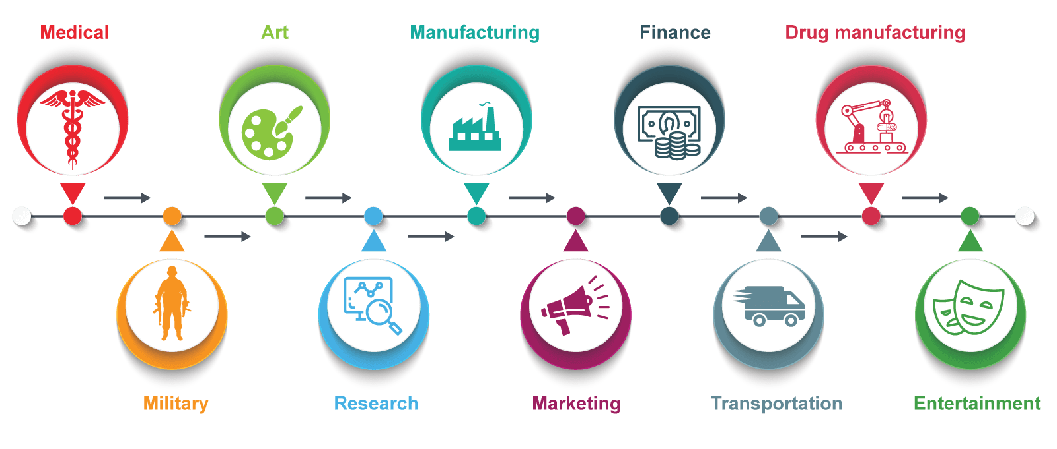
Fields of Applications…

Slide 11
Techniques to achieve AI
Rules and Logic Based Approach
Machine Learning Based Approach

Slide 12
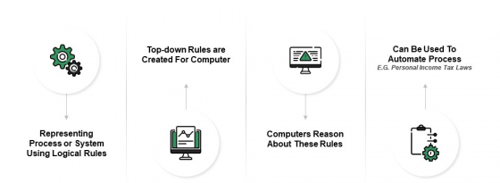
Rules and Logic Based Approach

Slide 13
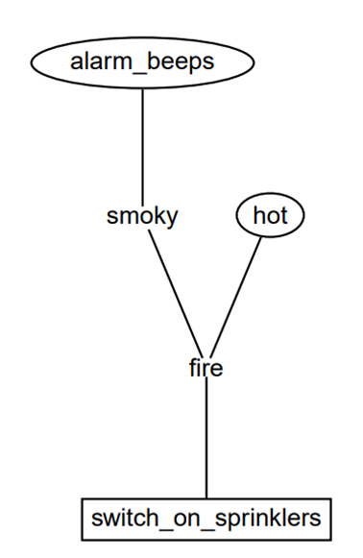
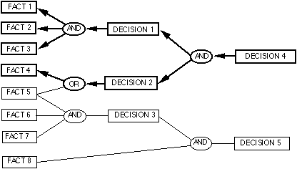
Working of Rules and Logic Based Systems

Slide 14

Problems with Logic and Rules-Based Approach
It takes lot of time to list out all the rules.
Changing rules is tedious.
As the list of rules grows, it becomes too difficult to manage and has a lot of redundancies.
The person who wrote the initial rules for you leaves, and you have to spend time and resources to catch up on the long list of rules.

Slide 15

Algorithms find patterns in data and infer rules on their own
“Learn” from data and improve over time
These patterns can be used for automation or prediction
ML is the dominant mode of AI today

Slide 16

Definition…
Machine Learning is the field of study that gives computers the ability to learn without being explicitly programmed.
- Arthur Samuel
A ** (computer program) is said to learn from experience E with respect to some class of tasks T and performance measure P, if its performance at tasks in T, as measured by P, improves with experience E.
- Tom Mitchell

Slide 17
Learning Systems
Task (T):
Classification
Regression
Transcription
Machine Translation
Captioning
Clustering
Anomaly Detection
De-noising
Performance Measure (P):
Accuracy
Precision
Recall
F1 Score
Mean Squared Error
BLUE
Silhouette Score
Similarity Measures
Experience (E):
Supervised
Un-supervised
Reinforced
Semi-supervised
Dataset

Slide 18
Machine Learning…
Machine learning is a tool for turning information into knowledge.
We are drowning in information and starving for knowledge.
Google: 24 petabytes of data are processed per day.
Facebook: 10 million photos are uploaded every hour.
You Tube: 1 hour of video is uploaded every second.
Twitter: 400 million tweets are posted per day.
We are DATAFIED! Wherever we go, we leave a data trail. Data becomes fruitless unless we discover the hidden patterns.
Wondering how? Yes! Machine Learning is a magic wand that turns information into knowledge, which will do wonders for humankind.

Slide 19
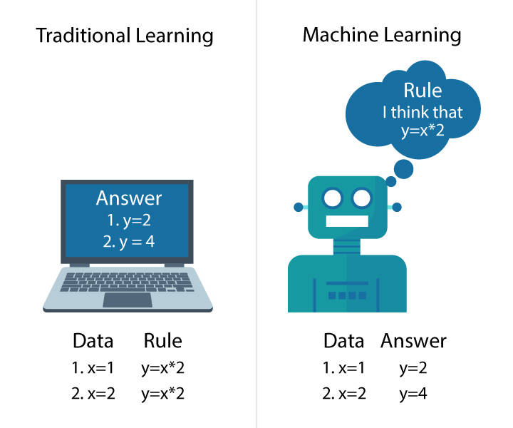
How Machine Learning is different from Traditional Learning…?

Slide 20
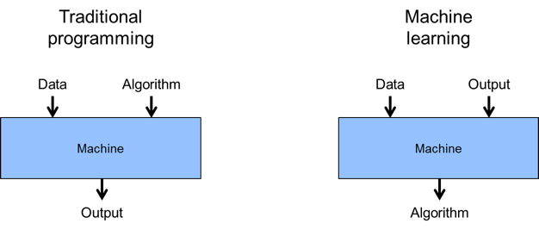
Traditional Programming vs Machine Learning

Slide 21
Why Machine Learning…?
We interact with Machine Learning models every single day without our knowledge.
Every time we perform a Google search, listen to a song or even take a photo, Machine Learning is becoming a backbone process behind it by invariably learning and improving from every interaction.
Machines can drive your car for you, detect eye diseases, unlock your phone with face recognition, and the list never ends.

Slide 22
What is the life cycle of Machine Learning?
The Machine Learning process lies in 9 steps:
Defining Project Objectives
Gathering Data
Exploratory Data Analysis (EDA) and Data Cleaning
Choosing a Model
Training
Evaluation
Hyperparameter Tuning
Interpret and Communicate
Deployment and Documentation

Slide 23
Defining Project Objectives
The first step of the life cycle is to recognize the opportunity for tangible improvement of activities, enhance customer satisfaction, or create value otherwise.
It is critical that you understand the problem you are trying to solve. In this stage, you should also be identifying the central objectives of your project by identifying the variables that need to be predicted.

Slide 24
Gathering Data
This is considered to be the primary step of the Machine Learning process.
The quality and quantity of data you gather in this step will determine how efficient your model will be.
Some important things to remember while gathering data are:
Data can be collected from anywhere in any format.
More training examples will aid the model to be more efficient.
Make sure the number of samples for every class or topic is not overly imbalanced.
Ensure that your samples adequately cover the space of possible inputs, not only the common cases.

Slide 25
Exploratory Data Analysis (EDA) and Data Cleaning
Exploratory Data Analysis (EDA):
Analyzing datasets to summarize their notable characteristics is called Exploratory Data Analysis.
It helps in performing investigations on data to discover hidden patterns, anomalies, and so on.
It aids in checking assumptions and hypothesis with the help of summary statistics.
Data Cleaning:
Data can have several shortcomings. A few are:
Missing values
Duplicate data
Invalid data
The process of detecting, correcting, and ensuring that the given dataset is error-free, consistent enough to use, is called Data Cleaning.

Slide 26
Choosing a Model
There are numerous models that researchers and Data scientists have created over the years.
Some are very well-suited for image data, while others are suited for sequences, text-based data, and many more.
Choosing the right model for the problem will impact the efficiency of the model.

Slide 27
Training
The next step of the Machine Learning process, often known as the bulk of ML, is Training the model.
This step is very similar to a person who is learning to drive for the first time. Though they do not know any of the basics initially, a licensed driver emerges eventually, after a lot of practice and feedback.
The data is split into Training Data and Testing Data.
The model is trained with the training data using different ML algorithms by adjusting the parameters in multiple iterations.
The testing data is put aside as unseen data to evaluate your models.

Slide 28
Evaluation
Once the training is complete, it is time to see if the model is any good, using Evaluation.
This is where that dataset that we set aside earlier comes into play, that is, Testing Data.
Evaluation allows us to test our model against the data that has never been used for training.
This metric will enable us to see how the model might perform against data that it has not yet seen.
This is meant to be representative of how the model might perform in the real world.

Slide 29
Hyperparameter Tuning
After the evaluation step, it is time to see if we can further improve our training by tuning different parameters that were implicitly assumed in the training process. This process is called Hyperparameter Tuning.
The tuned model is once again evaluated for model performance, and this cycle continues until the final best performing model is chosen.

Slide 30
Interpret and Communicate
The most challenging task of the ML project is explaining the model's output.
During the earlier days, Machine Learning was considered a BlackBox because it was hard to interpret their insights and values.
The more interpretable your model is, the easier it is to communicate your model's importance to the stakeholders.

Slide 31
Deployment and Documentation
Model deployment often poses a problem because of the coding and data science experience it requires and because the time-to-implementation of traditional data science methods from the start of the cycle is prohibitively long.
The trained model has to be deployed in a real-world system to be efficient to humans.
It can be deployed using any framework like Flask, Cloud, Azure, and so on.
Document your project well for your successors to handle it.

Slide 32
Types of Machine Learning
Machine Learning is an umbrella term that covers 3 learning techniques.
Supervised Learning
Unsupervised Learning
Reinforcement Learning

Slide 33
Supervised Learning
Supervised learning is the Machine Learning task of learning a function that maps an input to an output based on example input-output pairs.
It infers a function from labeled training data.
Each training example is a pair consisting of an input object and the desired output value.
A supervised learning algorithm analyzes the training data and produces an inferred function, which can be used for mapping new examples.
Applications:
Spam Detection
Pattern Recognition
Speech Recognition

Slide 34
Unsupervised Learning
Unsupervised Learning helps in uncovering hidden patterns from unlabeled data.
Applications:
Recommender Systems
Targeted Marketing
Customer Segmentation
Structure Discovery

Slide 35
Reinforcement Learning
Reinforcement Learning is a type of Machine Learning in which software agents ought to take actions in an environment to maximize the notion of cumulative reward.
Applications
Genetics
Economics
Robot Navigation

Slide 36
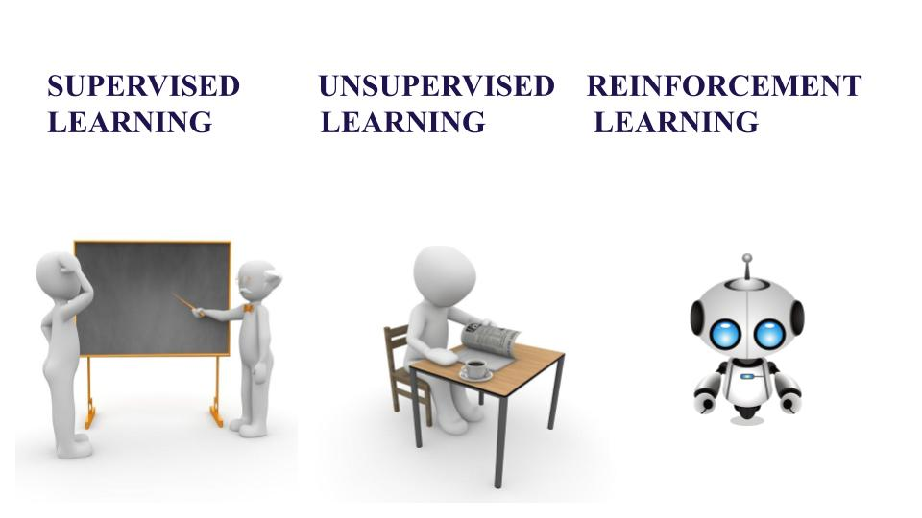
Supervised vs Unsupervised vs Reinforcement

Slide 37
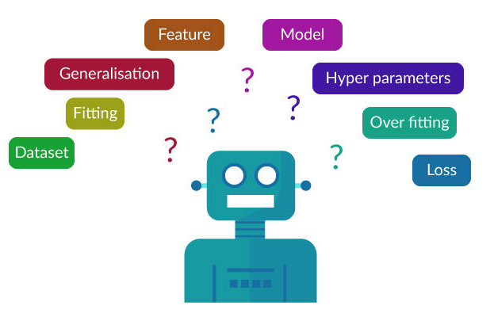
Frequently Used ML Terminologies

Slide 38
Machine Learning techniques
Supervised Techniques
Classification
Regression
Unsupervised Techniques
Clustering
Dimensionality Reduction
Association Rule Mining
Outlier Detection

Slide 39
Classification
Classification is the process of identifying a category to which a new observation belongs, based on a training set of data containing observations whose categories are already known.
It follows a two-step process, namely:
Learning Step - Training phase where a model is constructed.
Classification Step - Predicting the class labels and testing the same for accuracy.
Classification predicts the value of the categorical variables.

Slide 40
Regression
Regression analysis is a statistical method that aids in examining the relationship between two or more variables of interest.
It examines the influence of one or more independent variables on a dependent variable.
Types of Regression:
Linear Regression
Single Variable Linear Regression
Multiple Linear Regression
Polynomial Regression

Slide 41
Clustering
Clustering is the task of grouping a set of objects, such that objects in the same cluster are similar to each other when compared to the objects in the other clusters.
Distance measure plays a significant role in clustering.
The common distance measures used in various datasets are as follows.
Numeric Dataset
Manhattan distance
Minkowski distance
Hamming distance
Non-Numeric Dataset
Jaccard index
Cosine Similarity
Dice Coefficient

Slide 42
Dimensionality Reduction
Dimensionality reduction refers to techniques for reducing the number of input variables in training data.
Fewer input dimensions often mean correspondingly fewer parameters or a simpler structure in the machine learning model, referred to as degrees of freedom.
A model with too many degrees of freedom is likely to overfit the training dataset and therefore may not perform well on new data.
It is desirable to have simple models that generalize well, and in turn, input data with few input variables.
Techniques:
Feature Selection
Dimensionality Reduction

Slide 43
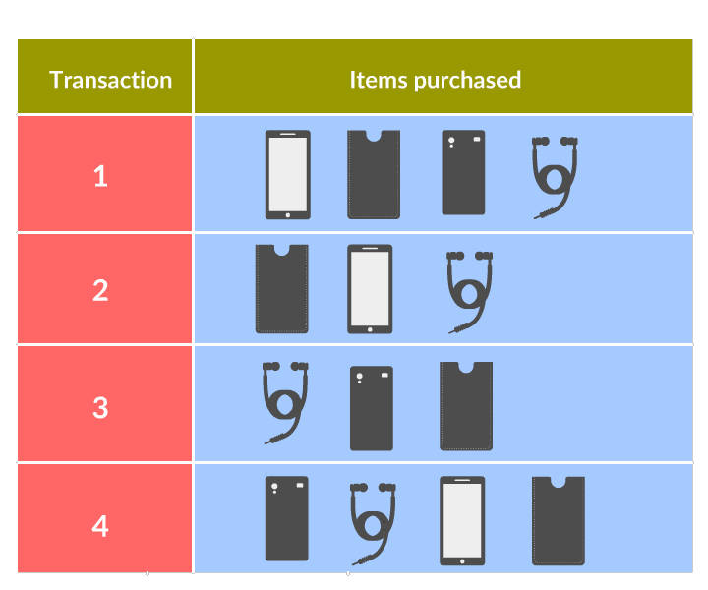
Association Rule Mining

Slide 44
Outlier Detection
A data object that deviates significantly from the normal objects as if it were generated by a different mechanism.
The types of Outlier are as follows:
Global Outlier: Global Outlier significantly deviates from the entire dataset.
Contextual Outlier: Contextual Outlier significantly deviates based on the context selected.
Collective Outlier: Collective Outlier is a subset of data objects that collectively deviates from the entire dataset.

Slide 45
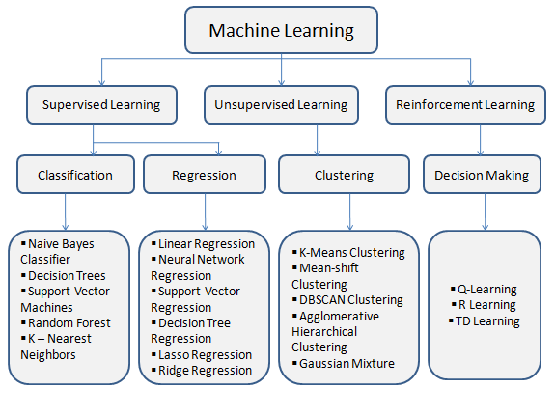
ML Algorithms based on Technique

Slide 46
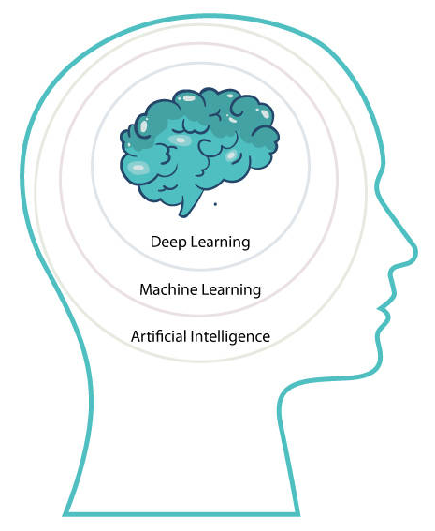
Deep Learning…
Deep Learning is a type of Machine Learning that is inspired by the structure of the brain for learning representations of data.
Exceptional effective at learning patterns.
Deep learning algorithms attempt to learn (multiple levels of) representation by using a hierarchy of multiple layers.
If you provide the system tons of information, it begins to understand it and respond in useful ways.
Involves networks which are capable of learning from data and functions similar to the human brain.

Slide 47
Why Deep Learning…?
Processes massive amount of data
Deep Learning can process an enormous amount of both Structured and Unstructured data.
Performs Complex Operations
Deep Learning algorithms are capable enough to perform complex operations when compared to the Machine Learning algorithms.
Achieves Best Performance
As the amount of data increases, the performance of Machine Learning algorithms decreases.
On the other hand, Deep Learning maintains the performance of the model.
Feature Extraction
Machine Learning algorithms extract patterns from labeled sample data, while Deep Learning algorithms take large volumes of data as input, analyze them to extract the features on its own.

Slide 48
Why Deep Learning…?
Manually designed features are often over-specified, incomplete and take a long time to design and validate
Learned Features are easy to adapt, fast to learn
Deep learning provides a very flexible, (almost?) universal, learnable framework for representing world, visual and linguistic information.
Can learn both unsupervised and supervised
Effective end-to-end joint system learning
Utilize large amounts of training data

Slide 49
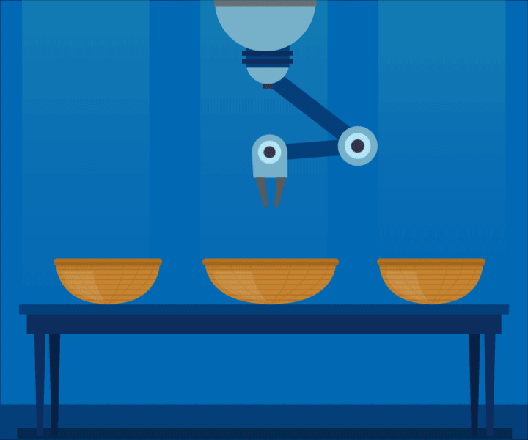
Deep Learning vs. Machine Learning
Say, for instance, we develop a machine that differentiates between cherries and tomatoes.
Machine Learning
If done through Machine Learning, we need to specify the features based on which the two can be differentiated like size and stem, in this case.
Deep Learning
In Deep Learning, the features are picked by the Neural Network without any human intervention. But, that kind of independence can be achieved by a higher volume of data in training the machine.

Slide 50
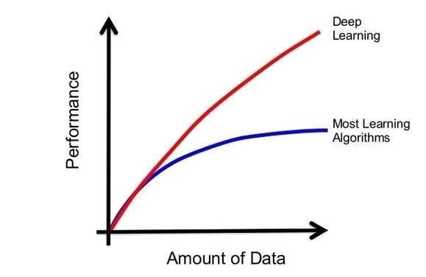
Amount of Data vs Performance in Deep Learning

Slide 51
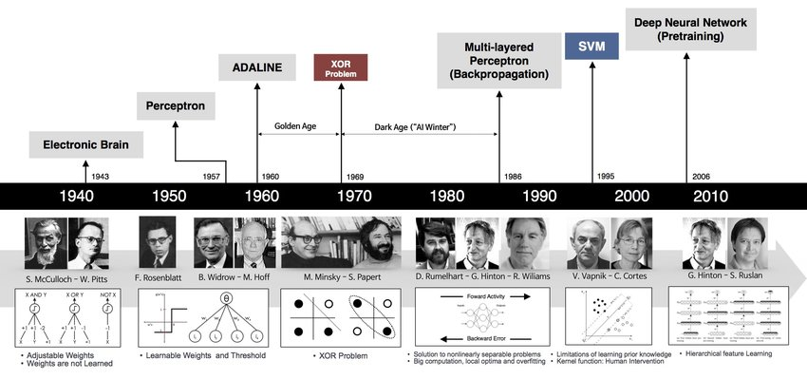
History of Deep Learning

Slide 52

Applications: Image Analysis
Image Classification
Object Recognition
Semantic Segmentation
Instance Segmentation

Slide 53
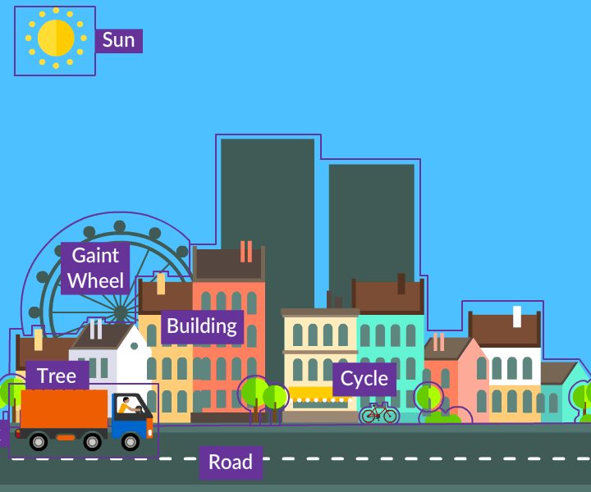
Applications: Video Analysis
Video Classification
Video Recognition
Video Captioning

Slide 54

Applications: Text Analysis
Machine Translation
Sentiment Analysis
Document Classification
Question Answering
Conversational Boats

Slide 55
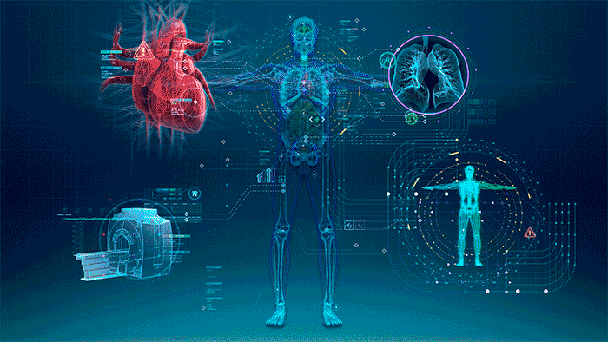
Applications: Medical Image Analysis

Slide 56
Deep Learning Libraries
Libraries are a predefined set of functions and modules that can be included in our code to achieve a particular task.
There are plenty of libraries in deep learning, each with its advantages and limitations.
This topic covers the brief overview of deep learning libraries like Theano, Deeplearning4j, Torch, Caffe, and TensorFlow.

Slide 57

Theano
Theano is a Python library.
It was developed by a machine learning group headed by Yoshua Bengio at the University of Montreal.
It is more a research platform than a deep learning library.
You must perform more work by yourself to generate the models that you want.
It does not have any deep learning classes within itself.

Slide 58
Theano - Features
Theano allows us to define mathematical expressions as a set of vectors and matrices. This avoids too many for loops in our code and greatly reduces the computation time.
Theano is best suited when we are going to build everything from scratch. It just aids in representing our deep net in terms of vectors and matrices.
Some of the optimization techniques used by Theano are the use of GPU for computations, arithmetic simplification, constant folding, using memory aliasing to avoid calculation, etc.
Popular libraries like Keras, Lasagne, Blocks, and Pylearn2 are built on top of Theano.

Slide 59
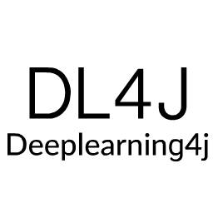
DeepLearning4J
DeepLearning4J (DL4J) is a Deep Learning framework created in Java and JVM languages for using in commercial deep learning projects.
Adam Gibson developed DL4J.
DL4J is utilized in business environments on distributed CPUs and GPUs, making it ideal for commercial-grade applications.

Slide 60
DeepLearning4J - Features
DL4J runs on distributed GPUs and CPUs.
It allows us to tune the deep net by selecting values for hyper parameters
It supports most of the deep nets like DBN, RBN, CNN, RNTN, auto encoders, Recurrent net and vanilla MLP.
It also includes vectorization library called Canova and distributed multi-node map reduce procedure for training the model.

Slide 61

Torch
Torch is a Lua deep learning framework developed by Koray Kavukcuoglu, Clement Farabet and Ronan Collobert for research and development activities into deep learning algorithms.
Torch is written in LuaJit (framework in Lua programming language) with an underlying C implementation.
It has also been further contributed by Facebook, Google DeepMind, Twitter and a host of others.
Popular applications of Torch are for supervised image problems with Convolutional Neural Networks and agents in more complex domains with deep reinforcement learning.

Slide 62
Torch - Features
Torch allows us to set up, train, and model deep net by configuring its hyperparameters.
Fast and efficient GPU support.
Provides built-in functions for indexing, transposing, slicing and numeric optimization.
Embeddable, with ports to iOS and Android backends.

Slide 63

Caffe
Caffe library was developed by Yangqing Jia at the Berkeley Vision and Learning Center for supervised computer vision problems.
It is written in C++ with a Python interface
It is mainly suited for machine vision tasks and also supports speech and text, reinforcement learning and recurrent nets.

Slide 64
Caffe - Features
An application can easily switch between CPU and GPU since Caffe is written in C++ with CUDA (a parallel computing platform).
You can build extremely complex deep net since it allows to perform highly sophisticated configuration on each layer.
It also includes Matlab and Python interfaces.
Caffe stores, communicates and manipulates the information as blobs that provides synchronization between CPU and GPU.

Slide 65

Tensor Flow
Tensor Flow is an open-source deep learning library from Google.
It is available on GitHub.
Its flexible architecture permits to use computation to one or more GPUs or CPUs in a server, desktop or mobile device with one API.

Slide 66
Tensor Flow - Features
It is similar to the computational graph where edges carry data as N-dimensional vector known as tensor and nodes represent mathematical operation which acts on the tensors.
Tensor flow lets you deploy parallel computing devices to execute operations quicker. Operations at the nodes are automatically scheduled for parallel computing.
It includes features such as auto differentiation, shared and symbolic variables, and common subexpression elimination.
It comes with visualization tools for graphically viewing different levels of the network, changes over time throughout the training process.

Slide 67
Metrics
Metrics are used to measure the performance of a neural network or any other model.
The commonly used metrics are error, accuracy, precision, and recall, F1-score.
Error is the ratio of the number of incorrect classification by a total number of classifications made by the net. This metric may be misleading if data is skewed over one class over other.
Accuracy, precision, recall and F1-score values are derived from confusion matrix (a table that is often used to describe the performance of a classification model) to know how well your model classifies the data.

Slide 68
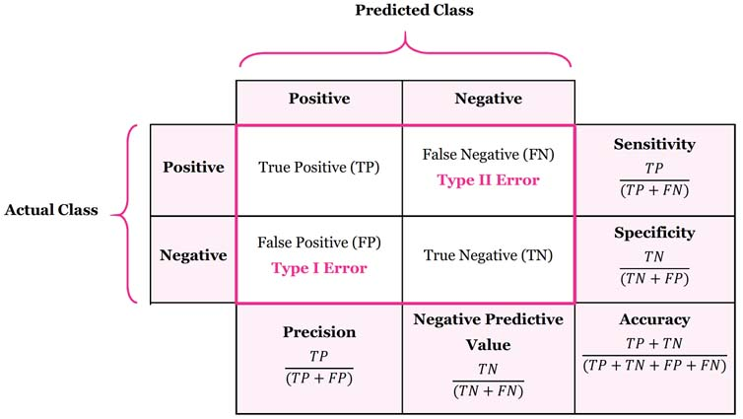
Confusion Matrix
Precision:
Out of predicted classification, what proportion actually predicted correctly?
True positive/(True positive + False positive)
Recall:
out of an actual number of classification, what proportion were classified correctly?
True positive/(True positive + False negative)

Slide 69
Human Information Processing System
Receptors
Neural Net
Effectors
Stimulus
Response

Slide 70
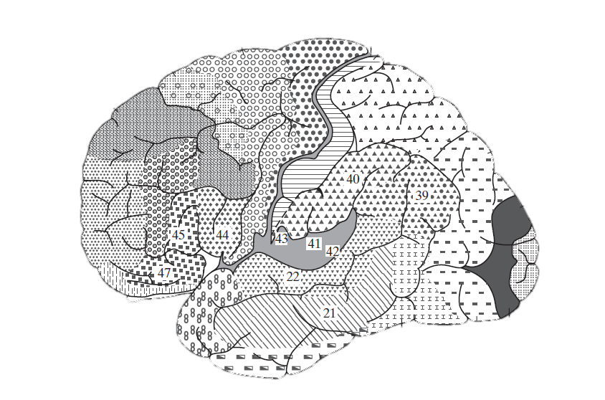

Human Information Processing System
The human brain contains billions of cells called Neurons. The structure of a neuron is depicted in the above image.
An average human brain has around 10^11 (100 billion) neurons!

Slide 71
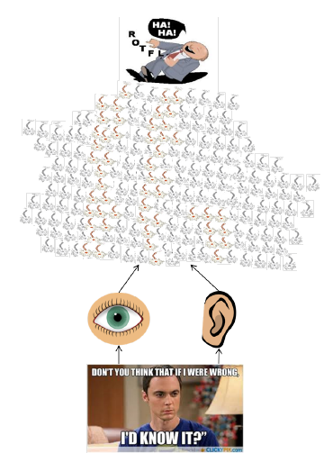
Information Flow in a Neural Network

Slide 72
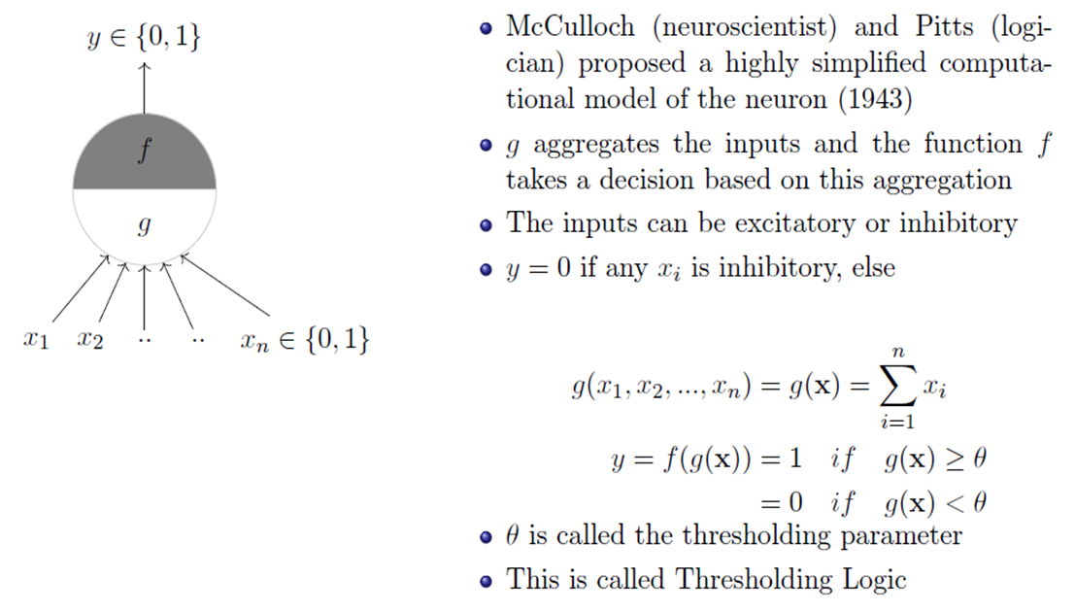
McCulloch and Pitts (MP) Neuron

Slide 73
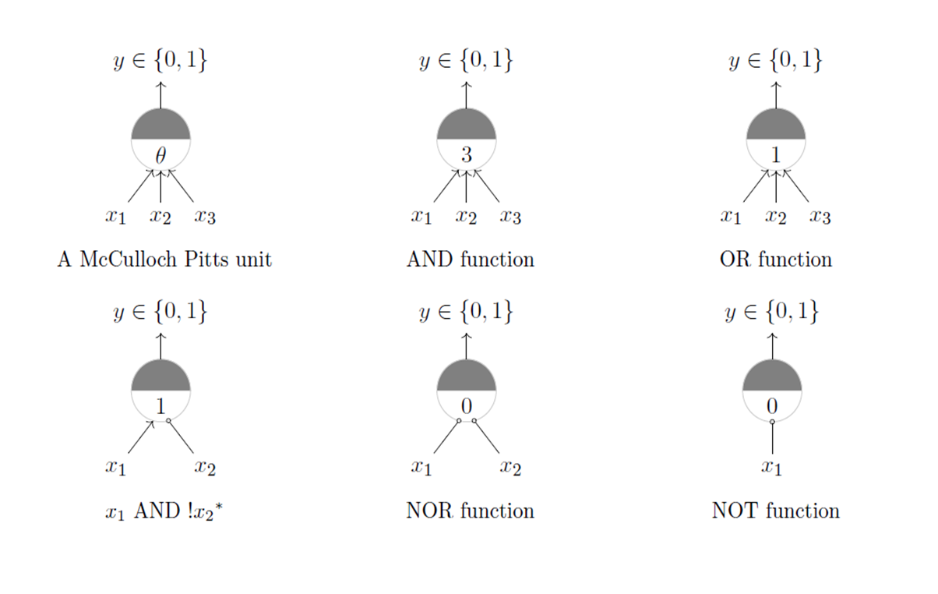
Realizing Boolean Logics using MP Neuron

Slide 74

Implementing MP Neuron in Python

Slide 75
Conclusion
A single McCulloch Pitts Neuron can be used to represent Boolean functions which are linearly separable

Slide 76
Problems with MP Neuron…
What about non Boolean (say, real) inputs ?
Do we always need to hand code the threshold ?
Are all inputs equal ? What if we want to assign more weight (importance) to some inputs ?
What about functions which are not linearly separable ?

Slide 77
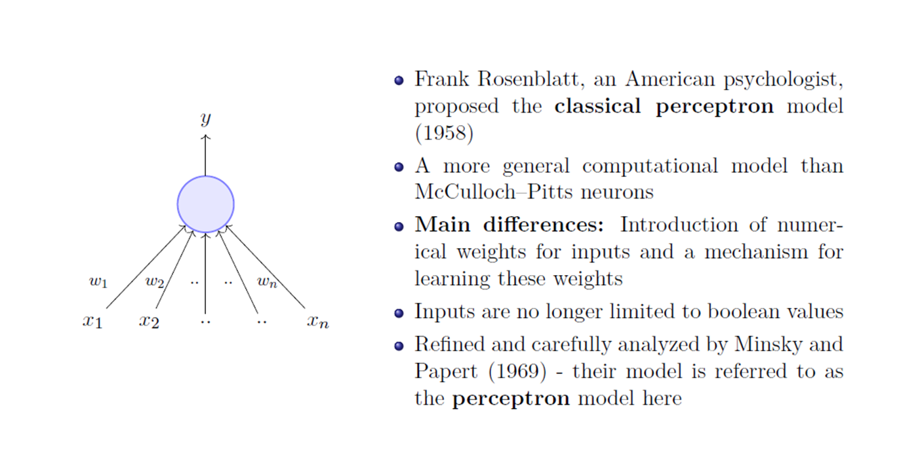
Perceptron

Slide 78
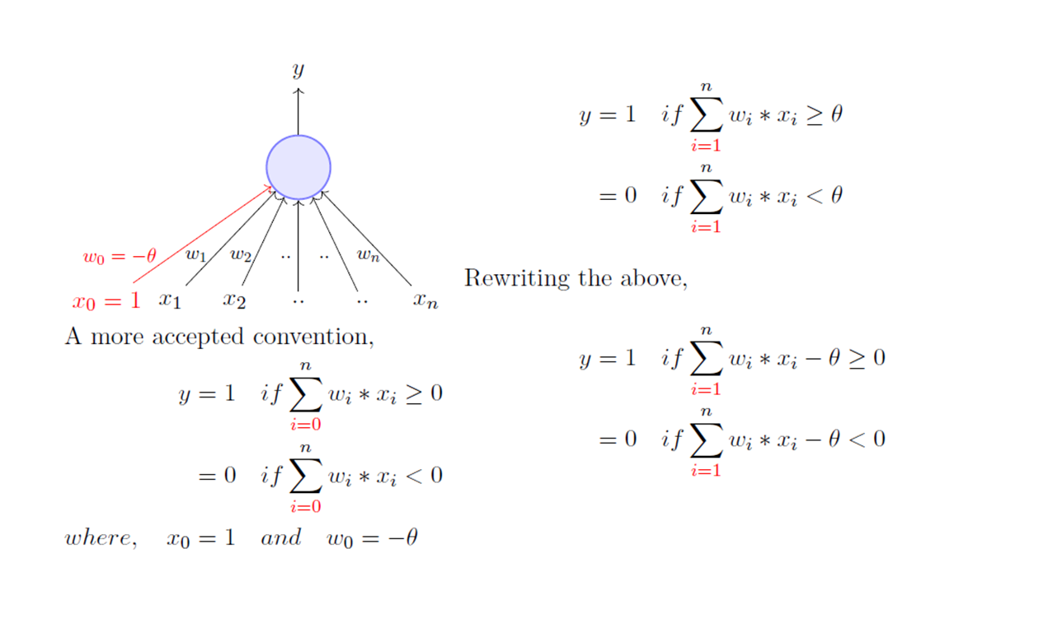
Perceptron

Slide 79
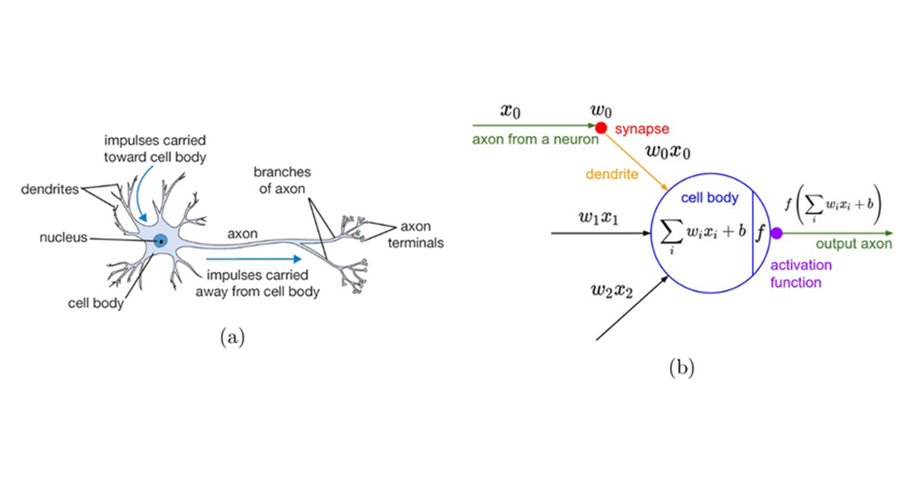
Biological vs Artificial Neurons

Slide 80
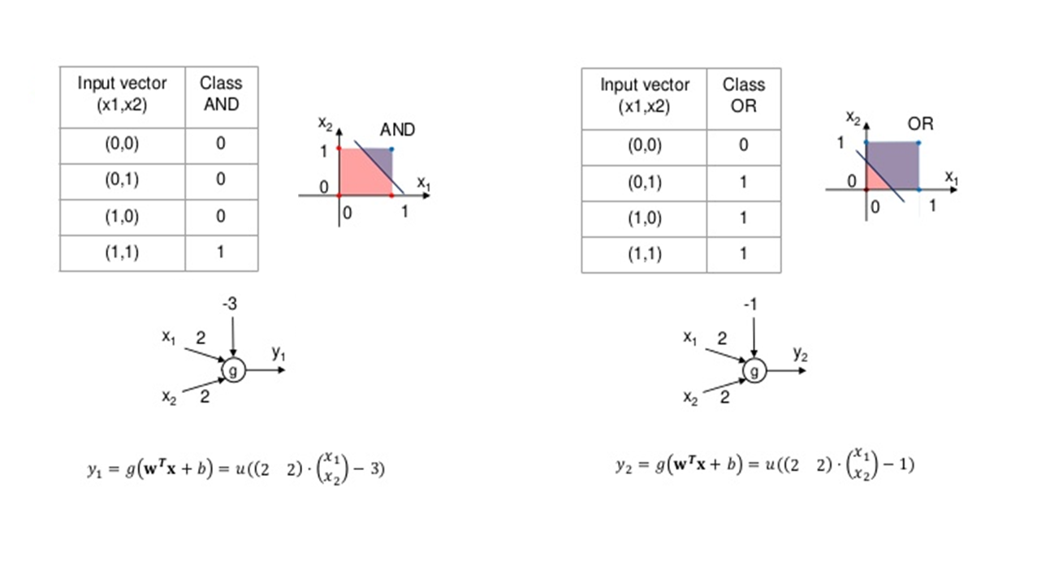
AND, OR Logic with Perceptron

Slide 81
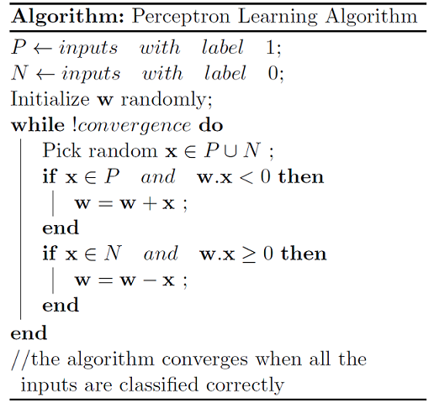
Perceptron Learning Algorithm

Slide 82
Implementing Perceptron in Python

Slide 83
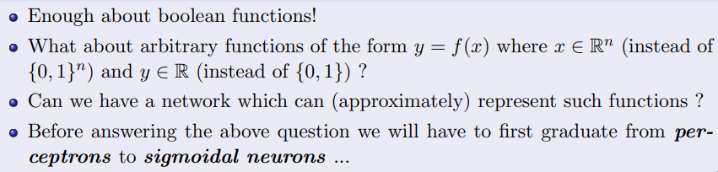
Intuition to Sigmoid Neuron

Slide 84
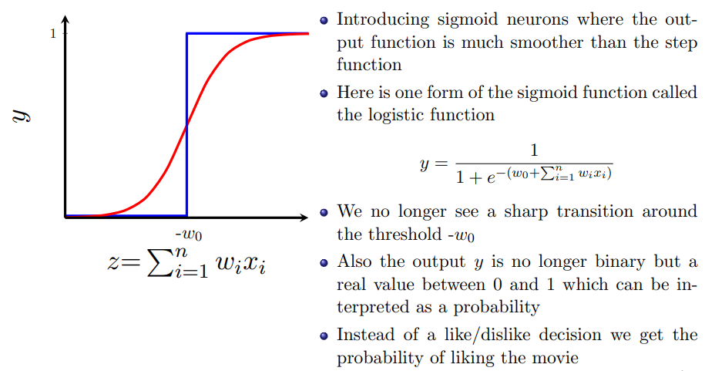
Sigmoid Neuron

Slide 85
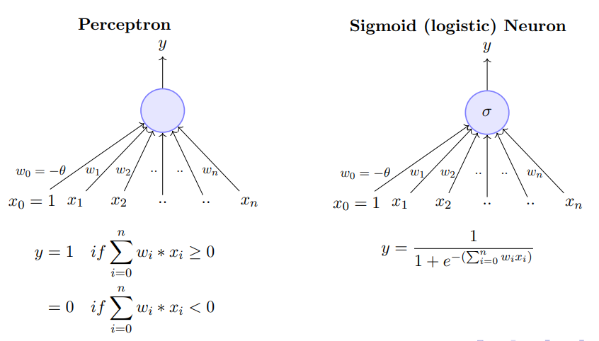
Perceptron vs Sigmoid Neuron

Slide 86
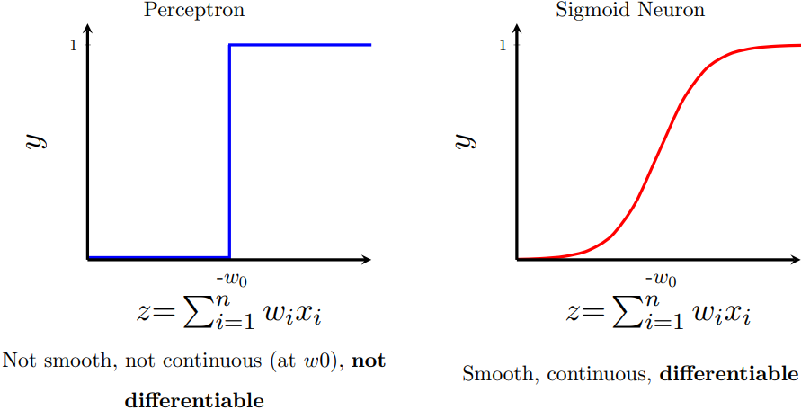
Perceptron vs Sigmoid Neuron

Slide 87
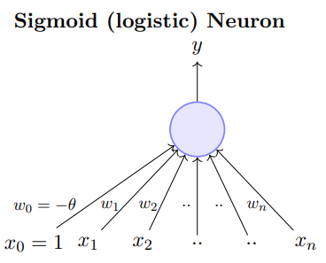
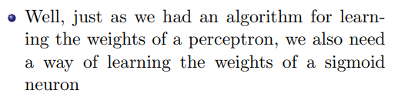
Learning Algorithm for Sigmoid Neuron

Slide 88
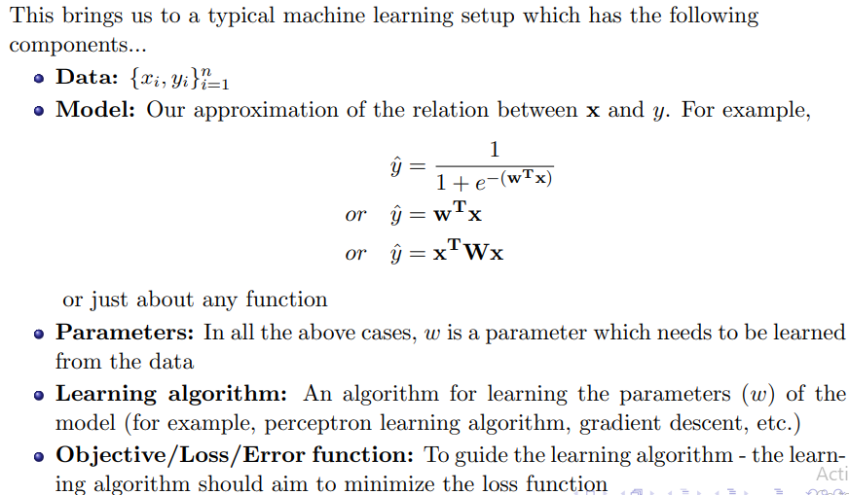
Learning Setup

Slide 89
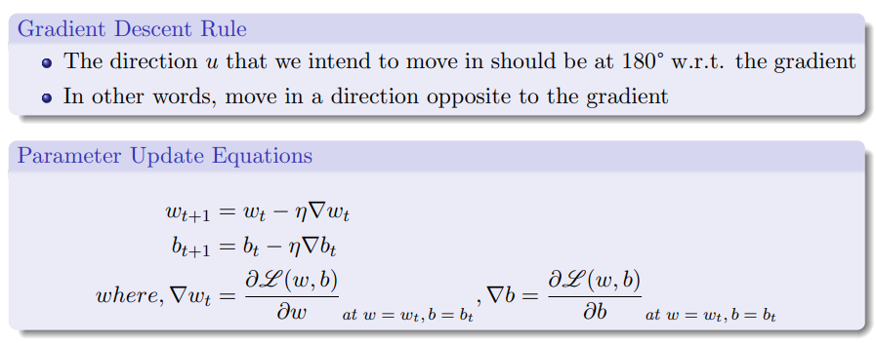
Gradient Descent for Learning Sigmoid Neuron Params

Slide 90
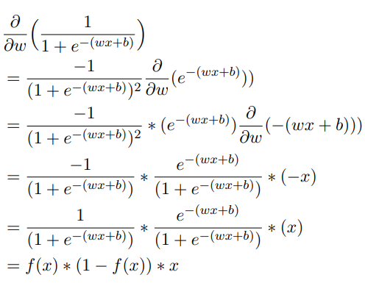
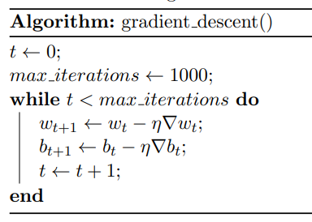
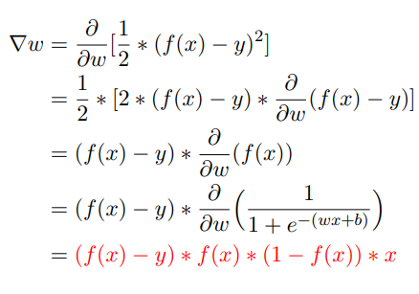
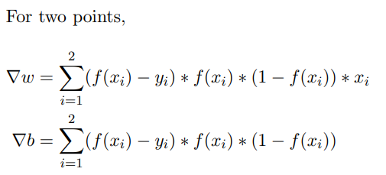
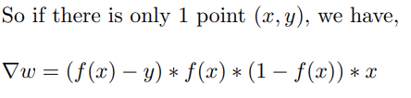
Gradient Descent Algorithm

Slide 91
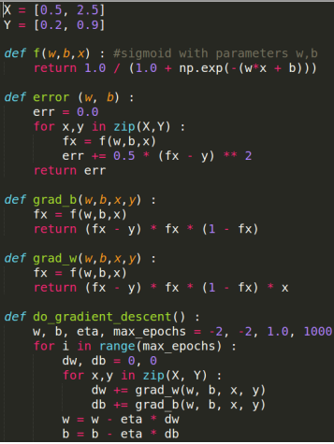
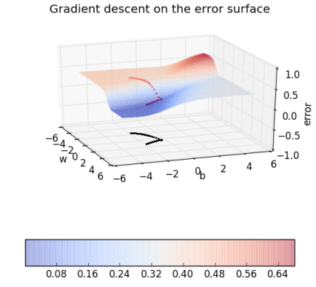
Implementing Gradient Descent

Slide 92
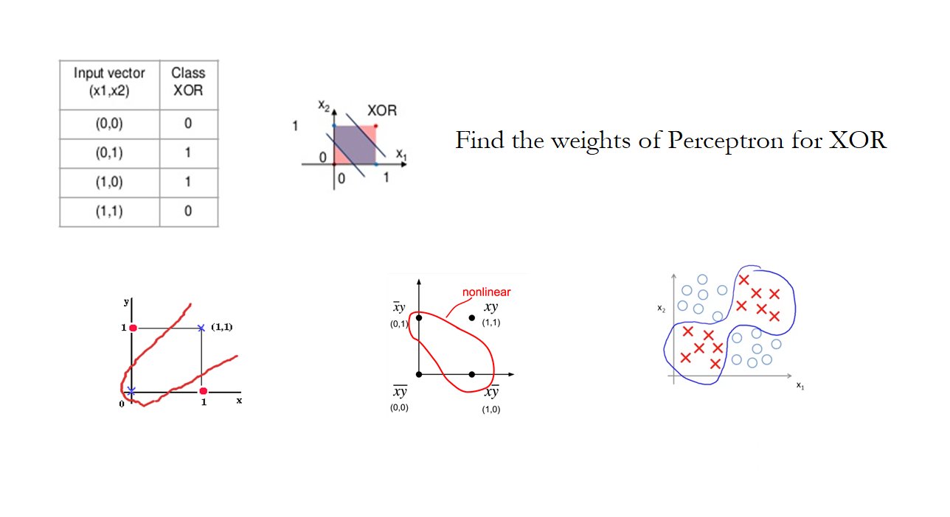
Perceptron / Sigmoid Neuron for XOR

Slide 93
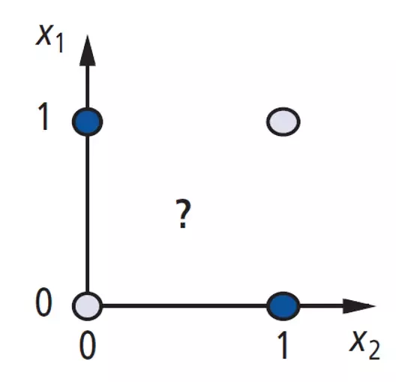
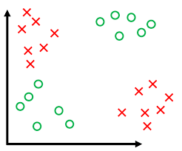
Perceptron - Failure
A "single-layer" perceptron can't implement XOR.
The reason is because the classes in XOR are not linearly separable.
You cannot draw a straight line to separate the points (0,0),(1,1) from the points (0,1),(1,0).
Led to invention of multi-layer networks.

Slide 94
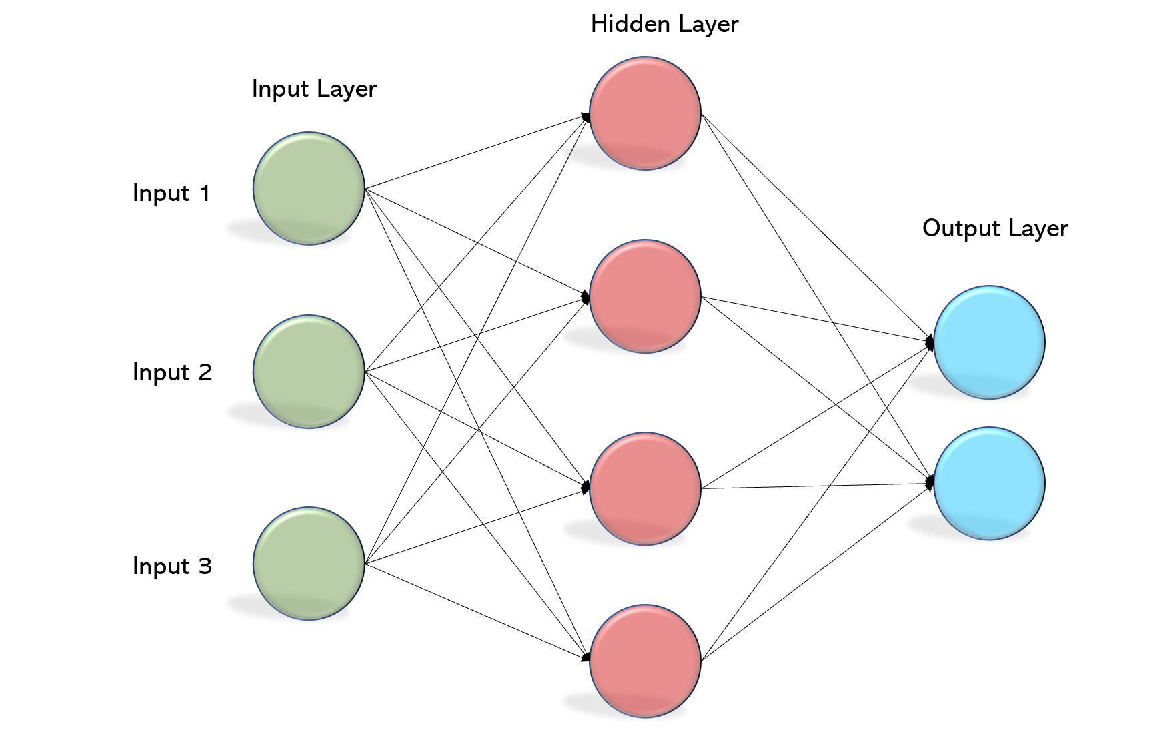
Multi Layered Perceptron - MLP
In the Multilayer perceptron, there can more than one linear layer (combinations of neurons).
There are three different layers in a MLP / Deep Neural Network, namely:
Input Layer
Hidden Layer
Output Layer

Slide 95
Structure of MLP
Input Layer:
The input layer communicates with the external environment and presents a pattern to the neural network.
Every neuron in the input layer represents an independent variable that influences the output.
Hidden Layer:
A Neural Network consists of several hidden layers, each consisting of a collection of neurons.
The hidden layer is an intermediate layer found between the input layer and the output layer.
This layer is responsible for extracting the features required from the input.
There is no exact formula for calculating the number of the hidden layers as well as the number of neurons in each hidden layer.
Output Layer:
The output layer of the neural network collects and transmits information in the desired format.

Slide 96
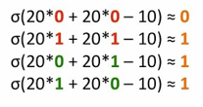
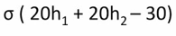
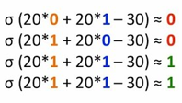

Learning XOR Problem
b1
W1
h1
X1
W5
b3
W2
σ
Y
W3
W4
h2
W6
X2
b2
(X1, X2) = {(0,0),(1,1),(0,1),(1,0)}
Y = {0,0,1,1}
W1 = 20, W2 = -20, W3 = 20,
W4 = -20, W5 = 20, W6 = 20
b1 = -10, b2 = 30, b3 = -30

Slide 97

Learning XOR Problem

Slide 98


Can you apply Perceptron Learning Rule for MLP…?

Slide 99


Back Propagation Learning Rule

Slide 100

Training Process in NN
Optimize (min. or max.) objective/cost function $J(θ)$
Generate error signal that measures difference between predictions and target values
Use error signal to change the weights and get more accurate predictions
Subtracting a fraction of the gradient moves you towards the (local) minimum of the cost function
Sample labeled data
(batch)
Forward it through the network, get predictions
Back-propagate the errors
Update the network weights

Slide 101

Gradient Descent – Optimization

Slide 102


Gradient Descent – Optimization

Slide 103


Error Surface

Slide 104

Optimizers

Slide 105

Back Propagation
“Backward propagation of errors”, is a mechanism used to update the weights using gradient descent.
Gradient descent is an iterative optimization algorithm to minimize the error function.
The weights are updated in the negative direction of the gradient to find a local minimum of a function

Slide 106

Forward Propagation
Out = f((w₅ * h₁) + (w₆ * h₂))
Out = f((w₅ * g₂(w₁*i₁ + w₂ *i₂) + (w₆ * g₂(w₃*i₁ + w₄ *i₂) ))
What can be varied to minimize error?

Slide 107

Forward Pass - Example
Our Single Sample: Inputs = [2, 3]
Output = [1]
Our Initial Weights:
w1 = 0.11
w2 = 0.21
w3 = 0.12
w4 = 0.08
w5 = 0.14
w6 = 0.15

Slide 108

Error Calculation

Slide 109

Error Calculation
Objective is to reduce the Error - Difference between Actual & Predicted.

Slide 110


Backword Pass – Update W6

Slide 111


Backword Pass – Update W1

Slide 112


Weight Update through Error propagation

Slide 113

Backward Pass - Example
Learning rate: is a Hyperparameter which means that we need to manually guess its value.

Slide 114

Back Propagation Algorithm

Slide 115
Animation
https://hmkcode.com/netflow/

Slide 116



Loss Functions

Slide 117

Activation Functions
Non-linearities needed to learn complex (non-linear) representations of data, otherwise the NN would be just a linear function
More layers and neurons can approximate more complex functions

Slide 118


Activation: Sigmoid
Takes a real-valued number and “squashes” it into range between 0 and 1.
Nice interpretation as the firing rate of a neuron
0 = not firing at all
1 = fully firing
Sigmoid neurons saturate and kill gradients, thus NN will barely learn
when the neuron’s activation are 0 or 1 (saturate)
gradient at these regions almost zero
almost no signal will flow to its weights
if initial weights are too large then most neurons would saturate

Slide 119



Activation: Tanh
Takes a real-valued number and “squashes” it into range between -1 and 1.
Like sigmoid, tanh neurons saturate
Unlike sigmoid, output is zero-centered
Tanh is a scaled sigmoid: $\tanh\left(x\right)=2sigm\left(2x\right)−1$

Slide 120

Activation: ReLU
Takes a real-valued number and thresholds it at zero
Most Deep Networks use ReLU nowadays
Trains much faster
accelerates the convergence of SGD
due to linear, non-saturating form
Less expensive operations
compared to sigmoid/tanh (exponentials etc.)
implemented by simply thresholding a matrix at zero
More expressive
Prevents the gradient vanishing problem

Slide 121

Tips to choose activation and loss functions

Slide 122

Batch Learning

Slide 123

Online Learning

Slide 124


Types of NNs based on Architectures
The architecture of a Neural Network can be broadly classified into two, namely:
Feed Forward Artificial Neural Network (DNN, CNN..)
Recurrent Neural Network (RNN, LSTM, GRU..)
The information must flow from input to output only in one direction.
No Feedback loops must be present.
Information can be transmitted in both directions.
Feedback loops are allowed.

Slide 125

Deep Neural Network (DNN)
A Deep Neural Network (DNN) is an Artificial Neural Network (ANN) with multiple layers between the input and output layers.
The DNN finds the correct mathematical manipulation to turn the input into the output, whether it be a linear relationship or a non-linear relationship.

Slide 126

What DNNs Learn…

Slide 127
MLP vs DNN
Number of Layers
Datasets (Size)
Computing Resources (Memory & Time efficient)
Weight Initialization
Non-linear activation Functions

Slide 128

MLP vs DNN

Slide 129
Implementing DNN in Python

Slide 130

Convolutional Neural Network…
Inspired by the human visual system
Convolutional Neural Networks is an extension of traditional Multi-layer Perceptron, based on 3 ideas:
Local receptive fields
Shared weights
Spatial sub-sampling
See LeCun paper (1998) on text recognition:
http://yann.lecun.com/exdb/publis/pdf/lecun-01a.pdf

Slide 131
Convolutional Neural Network (ConvNet)
A class of deep, feed-forward neural networks
Learns a complex representation of visual data using vast amounts of data.
Learns multiple layers of transformations, which are applied on top of each other to extract a progressively more sophisticated representation of the input.
CNN - multi-layer NN architecture
Convolutional + Non-Linear Layer
Sub-sampling Layer
Fully connected layers

Slide 132


Dense vs Sparse Layers
Dense
Sparse

Slide 133


Why CNN…?
Images are high-dimensional usually 112*196.
It would take a huge amount of parameters to characterize the network.

Slide 134
Layers of CNN
CNN has multiple hidden layers that help in extracting information from an image.
Convolution layer
Activation layer
Subsampling / Pooling layer
Fully connected layer

Slide 135

Intuition behind Convolutions
Different edge detection filters applied on input Image

Slide 136

Convolution Operation
Step-1: Overlay the filter to the input, perform element wise multiplication, and add the result.

Slide 137

Convolution Operation
Step-2: Move the overlay right one position (or according to the stride setting), and do the same calculation in step1. Repeat this.

Slide 138

Convolution Operation: Stride
Stride governs how many cells the filter is moved in the input to calculate the next cell in the result.

Slide 139
Convolution Operation: No Padding
The conv operation without padding results in the output smaller in size compared to the input
It is not possible to apply convolution on the borders of the image

Slide 140


Convolution Operation: Padding
Allows to retain the input size after convolution operation.
Allows to extract information from the borders.
As the size is retained allows more deeper layers

Slide 141


Convolution Operation
How to determine output dimension of the convolution layer..?

Slide 142

Convolution Operation: Multiple filters
Each filter learns different sets of features

Slide 143

Convolution Operation: RGB channels

Slide 144

Convolution Operation: RGB channels

Slide 145

Convolution Operation: RGB Multiple filters

Slide 146


Convolution + Activation Operation
ReLU

Slide 147


Pooling Operation

Slide 148

Flatten layer

Slide 149

Sample Architecture of CNN

Slide 150

What CNN Learns…?

Slide 151
Implementing CNN in Python

Slide 152
Problem With Overfitting
Large neural nets trained on relatively small datasets can overfit the training data.
This has the effect of the model learning the statistical noise in the training data, which results in poor performance when the model is evaluated on new data, e.g. a test dataset.
Generalization error increases due to overfitting.

Slide 153

Problem With Overfitting

Slide 154
Role of Dropout
Randomly Drop Nodes
Dropout is a regularization method that approximates training a large number of neural networks with different architectures in parallel.
During training, some number of layer outputs are randomly ignored or “dropped out.”
By dropping a unit out, we mean temporarily removing it from the network, along with all its incoming and outgoing connections.
Dropout simulates a sparse activation from a given layer, which interestingly, in turn, encourages the network to actually learn a sparse representation as a side-effect.
As such, it may be used as an alternative to activity regularization for encouraging sparse representation
Dropout: A Simple Way to Prevent Neural Networks from Overfitting, 2014.

Slide 155

Role of Dropout

Slide 156
Batch Normalization
Training deep neural networks, e.g. networks with tens of hidden layers, is challenging.
Training Deep Neural Networks is complicated by the fact that the distribution of each layer’s inputs changes during training, as the parameters of the previous layers change.
This slows down the training by requiring lower learning rates and careful parameter initialization, and makes it notoriously hard to train models with saturating nonlinearities.
Batch Normalization: Accelerating Deep Network Training by Reducing Internal Covariate Shift, 2015.
The authors of the paper introducing batch normalization refer to change in the distribution of inputs during training as “internal covariate shift.”

Slide 157

Batch Normalization

Slide 158
Problem with Deep Neural Networks
The downside of the Deep / Convolutional Neural Networks (CNN) is that they need enormous amounts of data for training.
This is usually scarce for most of the real-time applications.
This problem can be addressed by using Transfer Learning.
Traditionally Data Augmentation Techniques were also used to increase the size of training data and then train the models for desired task.
Transfer Learning shows effective results when in comparison with data augmentation techniques.

Slide 159
Implementing Regularized NNs

Slide 160

Transfer Learning…
Transfer learning is the improvement of learning in a new task through the transfer of knowledge from a related task that has already been learned.

Slide 161
Approaches
Two common approaches are as follows:
Develop Model Approach
Pre-trained Model Approach

Slide 162
Develop Model Approach
Select Source Task: You must select a related predictive modeling problem with an abundance of data where there is some relationship in the input data, output data, and/or concepts learned during the mapping from input to output data.
Develop Source Model: Next, you must develop a skilful model for this first task. The model must be better than a naive model to ensure that some feature learning has been performed.
Reuse Model: The model fit on the source task can then be used as the starting point for a model on the second task of interest. This may involve using all or parts of the model, depending on the modeling technique used.
Tune Model.: Optionally, the model may need to be adapted or refined on the input-output pair data available for the task of interest.

Slide 163
Pre-trained Model Approach
Select Source Model: A pre-trained source model is chosen from available models. Many research institutions release models on large and challenging datasets that may be included in the pool of candidate models from which to choose from.
Reuse Model: The model pre-trained model can then be used as the starting point for a model on the second task of interest. This may involve using all or parts of the model, depending on the modeling technique used.
Tune Model: Optionally, the model may need to be adapted or refined on the input-output pair data available for the task of interest.
This type of transfer learning is common in the field of deep learning.

Slide 164
Transfer Learning Strategies

Slide 165

Transfer Learning Strategies

Slide 166
How to select a best strategy..?

Slide 167

ImageNet Large Scale Visual Recognition Challenge
The ImageNet Large Scale Visual Recognition Challenge (ILSVRC) evaluates algorithms for object detection and image classification at large scale.
Millions of Labelled Images for Training
1000 Classes & Even more now
To know more: http://www.image-net.org/challenges/LSVRC/

Slide 168

Alex Net

Slide 169

VGG Net (16 Layers – VGG16)

Slide 170

VGG Net (19 Layers – VGG19)

Slide 171

Alex Net vs VGG Net

Slide 172


GoogLe Net - Inception

Slide 173


ResNet (50 Layers)

Slide 174

Performance of various Deep CNNs

Slide 175
Other Pre-trained Models
Xception
InceptionResNetV2
MobileNet (V2)
EfficientNetB0-B7
NASNet (Mobile & Large)

Slide 176
Using VGG16 Pre-trained Model for
Fine-tuning
Feature Extraction
https://keras.io/guides/transfer_learning/

Slide 177
Where this ball would go Next..?
?

Slide 178
Give Previous Positions…
?

Slide 179

Sequence Modeling
Sequence Modeling is the task of predicting what word/letter comes next.
Unlike the DNN and CNN, in sequence modeling, the current output is dependent on the previous input and the length of the input is not fixed.

Slide 180

Types of Sequence Modeling Tasks

Slide 181

Recurrent Neural Network (RNN)
A recurrent neural network is a class of artificial neural network where connections between nodes form a directed graph along a sequence.
This allows it to exhibit temporal dynamic behavior for a time sequence.
Unlike feedforward neural networks, RNNs can use their internal state to process sequences of inputs

Slide 182

Unfolding RNN

Slide 183

RNN
An RNN works like this; First words get transformed into machine-readable vectors.
Then the RNN processes the sequence of vectors one by one.

Slide 184

Hidden State Passing in RNN

Slide 185
Problem with RNN
RNNs suffer from the problem of vanishing gradients, which hampers learning of long data sequences.
The gradients carry information used in the RNN parameter update and when the gradient becomes smaller and smaller, the parameter updates become insignificant which means no real learning is done.

Slide 186
Implementing RNN for Sentiment Analysis

Slide 187

Long Short Time Memory - LSTM
An LSTM has a similar control flow as a recurrent neural network.
It processes data passing on information as it propagates forward.
The differences are the operations within the LSTM’s cells.
These operations are used to allow the LSTM to keep or forget information.

Slide 188
How LSTM Works..?
The core concept of LSTM’s are the cell state, and it’s various gates.
The cell state act as a transport highway that transfers relative information all the way down the sequence chain.
You can think of it as the “memory” of the network.
The cell state, in theory, can carry relevant information throughout the processing of the sequence.
So even information from the earlier time steps can make it’s way to later time steps, reducing the effects of short-term memory.
As the cell state goes on its journey, information get’s added or removed to the cell state via gates.
The gates are different neural networks that decide which information is allowed on the cell state.
The gates can learn what information is relevant to keep or forget during training.

Slide 189


LSTM: Forget Gate
Forget gate decides what information should be thrown away or kept. Information from the previous hidden state and information from the current input is passed through the sigmoid function. Values come out between 0 and 1. The closer to 0 means to forget, and the closer to 1 means to keep.

Slide 190

LSTM: Input Gate
To update the cell state, we have the input gate.
First, we pass the previous hidden state and current input into a sigmoid function.
That decides which values will be updated by transforming the values to be between 0 and 1. 0 means not important, and 1 means important.
You also pass the hidden state and current input into the tanh function to squish values between -1 and 1 to help regulate the network.
Then you multiply the tanh output with the sigmoid output.
The sigmoid output will decide which information is important to keep from the tanh output.

Slide 191

LSTM: Cell State
First, the cell state gets pointwise multiplied by the forget vector.
This has a possibility of dropping values in the cell state if it gets multiplied by values near 0.
Then we take the output from the input gate and do a pointwise addition which updates the cell state to new values that the neural network finds relevant.
That gives us our new cell state.

Slide 192



LSTM: Output Gate
The output gate decides what the next hidden state should be.
Remember that the hidden state contains information on previous inputs. The hidden state is also used for predictions.
First, we pass the previous hidden state and the current input into a sigmoid function. Then we pass the newly modified cell state to the tanh function.
We multiply the tanh output with the sigmoid output to decide what information the hidden state should carry. The output is the hidden state. The new cell state and the new hidden is then carried over to the next time step.

Slide 193
Implementing LSTM for Sentiment Analysis

Slide 194

Gated Recurrent Unit - GRU
A slight variation of the LSTM called the Gated recurrent unit(or GRU) was introduced in.
It uses a single update gate in place of the input and forget gates of the LSTM. It was found to be simpler than the standard LSTM variant and had fewer number of parameters, which resulted in faster training time than LSTMs.

Slide 195
Implementing GRU for Sentiment Analysis

Slide 196
Transformer
The Transformer architecture follows an encoder-decoder structure, but does not rely on recurrence and convolutions in order to generate an output.
In a nutshell, the task of the encoder, on the left half of the Transformer architecture, is to map an input sequence to a sequence of continuous representations, which is then fed into a decoder.
The decoder, on the right half of the architecture, receives the output of the encoder together with the decoder output at the previous time step, to generate an output sequence.

Slide 197

Architectural Overview

Slide 198
Working flow of a Transformer
Each word forming an input sequence is transformed into a dmodel-dimensional embedding vector.
Each embedding vector representing an input word is augmented by summing it (element-wise) to a positional encoding vector of the same dmodel length, hence introducing positional information into the input.
The augmented embedding vectors are fed into the encoder block, consisting of the two sublayers.
The first sublayer implements a multi-head self-attention mechanism. Multi-head mechanism implements h heads that receive a (different) linearly projected version of the queries, keys and values each, to produce h outputs in parallel that are then used to generate a final result.
The second sublayer is a fully connected feed-forward network, consisting of two linear transformations with Rectified Linear Unit (ReLU) activation in between.
Since the encoder attends to all words in the input sequence, irrespective if they precede or succeed the word under consideration, then the Transformer encoder is bidirectional.

Slide 199
Working flow of a Transformer
The decoder receives as input its own predicted output word at time-step, t–1.
The input to the decoder is also augmented by positional encoding, in the same manner as this is done on the encoder side.
The augmented decoder input is fed into the three sublayers comprising the decoder block.

Slide 200

Working flow of a Transformer
The first sublayer receives the previous output of the decoder stack, augments it with positional information, and implements multi-head self-attention over it. While the encoder is designed to attend to all words in the input sequence, regardless of their position in the sequence, the decoder is modified to attend only to the preceding words. Hence, the prediction for a word at position, i, can only depend on the known outputs for the words that come before it in the sequence. In the multi-head attention mechanism (which implements multiple, single attention functions in parallel), this is achieved by introducing a mask over the values produced by the scaled multiplication of matrices Q and K. This masking is implemented by suppressing the matrix values that would, otherwise, correspond to illegal connections.

Slide 201
Working flow of a Transformer
The second layer implements a multi-head self-attention mechanism, which is similar to the one implemented in the first sublayer of the encoder. On the decoder side, this multi-head mechanism receives the queries from the previous decoder sublayer, and the keys and values from the output of the encoder. This allows the decoder to attend to all of the words in the input sequence.
The third layer implements a fully connected feed-forward network, which is similar to the one implemented in the second sublayer of the encoder.
Masking is applied in the first sublayer, in order to stop the decoder from attending to succeeding words. At the second sublayer, the decoder also receives the output of the encoder, which now allows the decoder to attend to all of the words in the input sequence.
The output of the decoder finally passes through a fully connected layer, followed by a softmax layer, to generate a prediction for the next word of the output sequence.

Slide 202

Unfolded Transformer Architecture

Slide 203
Implementing Transformer for Sentiment Analysis

Slide 204
Hands-on Exercises
MP Neuron for Diabetes Prediction
Perceptron for Diabetes Prediction (scratch & sklearn)
MLP for Loan Prediction (sklearn)
DNN for Loan Prediction (BP scratch)
DNN for Image Classification (tensor flow)
CNN for Image Classification (tensor flow)
Regularized CNN for Image Classification (tensor flow)
VGG16 for Image Classification (Fine-tuning Approach)
VGG16 for Image Classification (Feature Extraction Approach)
RNN for Sentiment Analysis
LSTM for Sentiment Analysis
GRU for Sentiment Analysis
Transformer for Sentiment Analysis

Slide 205


